Slide 1
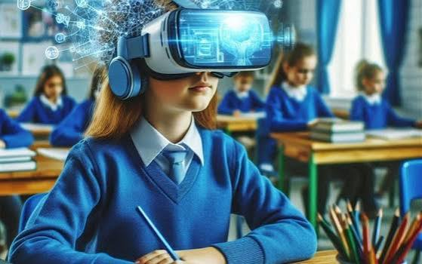
WELCOME
AI IN EDUCTION

Slide 2
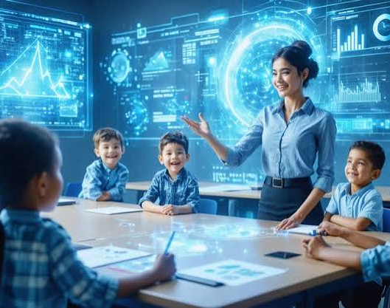
Introduction to AI
AI (Artificial Intelligence) means making computers and machines smart enough to think, learn, and solve problems like humans. It uses data and examples to learn patterns and then makes decisions or gives answers on its own, without a human telling it every step.

Slide 3

What is AI in Education
AI in education means using these smart computer programs inside schools, colleges, and learning apps. Instead of one teacher handling many students the same way, AI can look at each student's strengths and weaknesses and give lessons made just for them. It can also automatically check answers, explain difficult topics, and answer student questions anytime.

Slide 4
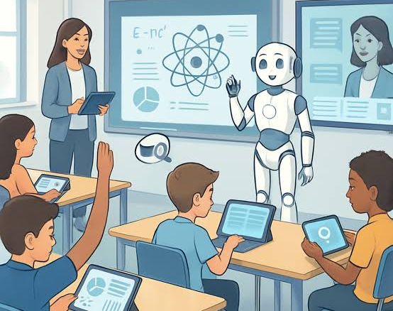
Benefits of AI in Education
Personalized learning: Every student gets lessons based on their own speed and level.
Instant feedback: Students know their mistakes right away instead of waiting for the teacher to check.
Saves teacher's time: AI can grade tests and homework automatically.
24/7 help: Students can ask doubts anytime, even at night, and get answers.
Makes learning fun: Using games, quizzes, and interactive tools keeps students interested.

Slide 5
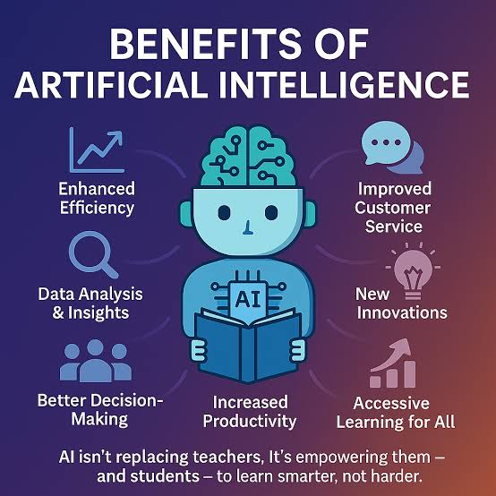
AI Tools Used in Education
ChatGPT – helps in writing, explaining topics, and answering questions.
Khanmigo – an AI tutor from Khan Academy that helps with study.
Grammarly – checks grammar and improves writing.
Google Classroom AI – helps manage assignments and grading.
Duolingo – uses AI to teach languages in a fun way.

Slide 6
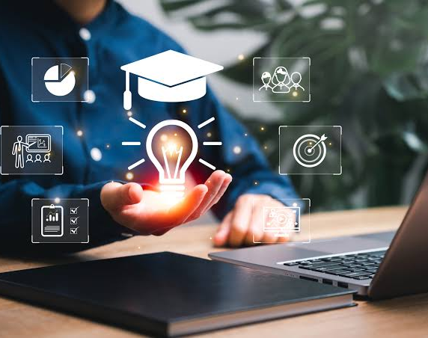
Uses of AI in Education
AI is used for online tutoring, automatic grading, creating smart study plans, translating languages, detecting plagiarism, and even predicting which students might need extra help based on their performance.

Slide 7
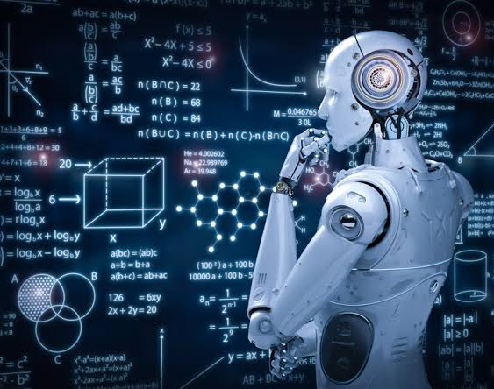
Challenges of AI in Education
High cost: Not every school can afford AI tools.
Less human touch: Too much AI can reduce personal connection between teacher and student.
Privacy issues: Student data safety is a big concern.
Over-dependency: Students might rely too much on AI instead of learning themselves.
Technical problems: Not every area has good internet or devices for AI tools.

Slide 8


